Slide 1
Privacy Oriented Phones Compared
Comparing the Pinephone, Librem 5, and Graphene OS.

Slide 2

Author Introduction: Kenneth Lindbloom
Houston Native
~15 Years in IT/IT Security
Currently working as a senior analyst at a Fortune 500 company in the energy sector.
Currently focused on Privileged Access Management & security automation
Interested in privacy issues, tinkering with Qubes OS and privacy-oriented phones.
Slides/Questions Email Me: klindbloom@tuta.com

Slide 3
Topic Overview
Privacy & Use Case
The Phones
Other Alternatives
User Experience
  Dealing with the vendors
  Using the different OSes
  Important Functions
  Availability of Specific Applications
  Special Uses
  Gotchas & Issues

Slide 4
Why this presentation?
Many online reviews don’t go into great depth.
Guides found online can be out of date.
Gotchas along the way.
Learn from my misadventures to choose which, if any of these phones is right for you.

Slide 5
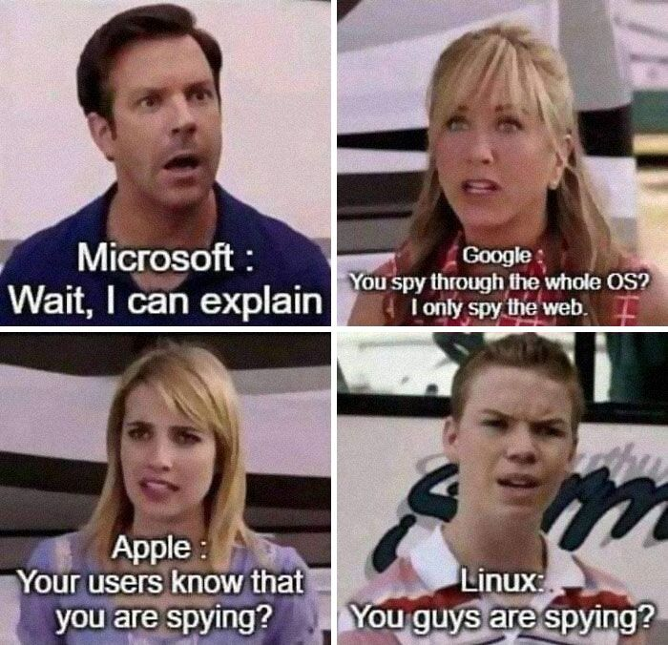
Privacy & Use Case
Privacy vs. Security
Bulk vs. Target Surveillance
Government vs. Corporate Surveillance
Surveillance In Layers
  Cellular Network
  Applications
  Operating System & Bloatware
  OpSec
Notes:
Security: safeguarding events impacting the Confidentiality, Integrity, and Availability of information resources. (my definition)
Privacy: “Privacy relates to any rights you have to control your personal information and how it’s used.“ -Norton
Bulk Surveillance -ongoing monitoring of phone calls, emails, SMS, etc using keyword monitoring and voice recognition
Targeted Surveillance -phone taps, app backdoors, geolocation information

Slide 6
Privacy & Use Case (continued)
Father wrongfully accused of possessing child pornography, due to Google’s analysis of his phone’s images. (2021)
Cyclist Zachary McCoy wrongfully accused of burglary based on geofence warrant. Spent thousands on legal fees. (2020)
Jorge Molina wrongfully arrested for murder, held in prison for six days, publicized in media, based on geofence warrant.
Phones listening to carry out commands, track data, deliver targeted advertisements.
Notes:
Links:
Sensorvault data used to catch grizzly poachers
FBI investigates arson with geofence warrant
Father wrongfully accused of possessing child pornography.
Cyclist Zachary McCoy wrongfully accused of burglary.
Jorge Molina wrongfully arrested for murder, held in prison for six days, publicized in media, based on geofence warrant. Dropped out of school, lost his job, lost his car, his reputation destroyed, and he lives with nightmares about being in prison.
FBI investigates arson with geofence warrant

Slide 7
Privacy & Use Case (continued)
Concerns
Erosion of 4th Amendment Rights
  Wrongful arrests and prosecutions based off of geofence warrants
  3rd Party Doctrine and the blurring of government and corporate surveillance
Data Brokers: Last Week Tonight With John Oliver
  Anyone can buy this information
Data Breaches
Deplatforming
Creepy Advertising
Notes:
Links:
Data Brokers – John Oliver
What is 3rd Party Doctrine?
Deplatforming – expanding on the Google child porn case…

Slide 8

Privacy & Use Case (continued)
Sources For Additional Information
Rob Braxman’s YouTube Videos
Mental Outlaw (YouTube channel)
Interviews with Edward Snowden

Slide 9
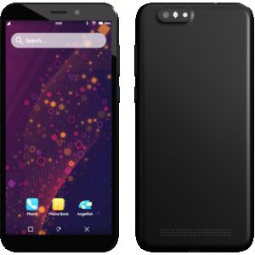
Pinephone -Hardware, Notable Features & Issues
Multiple Editions Available
  Beta Edition (w/wo convergence)
  Pro Edition (not available?)
  Community Edition (not available?)
Expandable Hardware Functionality
Hardware Kill Switches
User Replaceable & Upgradeable Battery
Convergence
(pine64.com)
Notes:
Expandable Hardware Functionality:
Fingerprint Reader Add-On Case
Wireless Charging Case
LORA Add-On Case
Keyboard
Convergence
Replaceable Battery
J7 Format
Upgradeable from 3000mAh to 3500mAh

Slide 10
Pinephone -Hardware, Notable Features & Issues
Expandable storage with microsd card
Wide range of operating systems available
Bootable from internal memory or microsd
  Simple to format and install an OS
  Dual boot setup interferes with storage
  Better to install OS to microsd
Camera Specs, ram, and internal storage vary based on model
  Lower Spec Models: 2-3GB Ram, 16GB storage, 5mp front camera, 2mp rear camera
  Pro: 4GB Ram, 13mp front camera, 8mp rear camera, 128GB storage
Notes:
Operating Systems
Ubuntu Touch felt like it would be the most user friendly if I could get it to work.
Mostly experimented with Postmarket OS & Arch, because I was able to get Waydroid installed on them.
There’s a multi-distro option that is useful for taking multiple operating systems for a test drive

Slide 11

Pinephone -Hardware, Notable Features & Issues
Factory soft and hard cases are awful
fitBAGs are awful (picture on the right)
3d printed cases are questionable
Screen protector is available from Pine64
Difficult to use one handed
Soft plastic bezel damages easily
Sometimes a little laggy
fitBAG available on Amazon

Slide 12
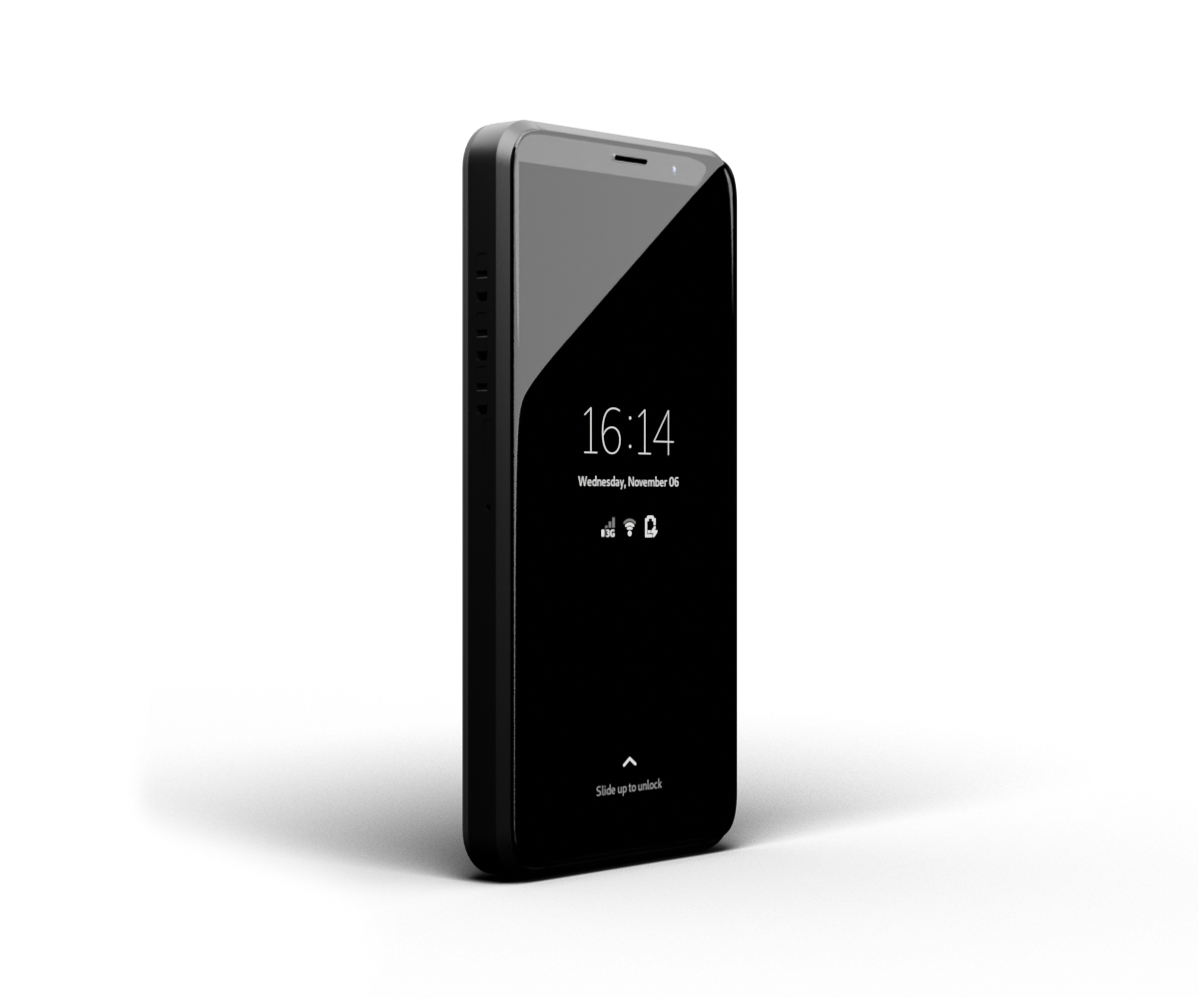
Librem 5 -Hardware, Notable Features & Issues
Two Versions
  Standard (expensive)
  USA (even more expensive)
External Hardware Kill Switches
Replaceable 4500mAh Battery
Convergence
OpenPGP Card Reader
https://puri.sm

Slide 13
Librem 5 -Hardware, Notable Features & Issues
Example storage via microsd card
Bootable from internal memory only
PureOS & Postmarket OS available, install is more tricky
  Purism utility script
  Expanding PureOS storage after reinstall
  FDE with PureOS
  Easy FDE with Postmarket OS
Specs: 3GB Ram, 32GB internal storage, 13mp rear camera, 8mp front camera

Slide 14
Librem 5 -Hardware, Notable Features & Issues
Cases
  No commercial options
  Phone is big enough already
  3d printed cases are chunky
The phone chassis is aluminum and acts a heatsink.
Screen protector is available.
Privacy screen is available.
Noticeably less laggy than the Pinephone

Slide 15

GrapheneOS
Available on Google Pixel Phones Only
Open Source project original tied to Copperhead OS
Pixel phones feel like any other smartphone
Cases and screen protectors are plentiful
Baseband is isolated
Headphones
  No headphone jack
  USB C headphones work, but you have to make an adjust each time you connect them under Connected Devices
https://grapheneos.org

Slide 16
The Vendors
Pine64 | https://www.pine64.org/
Purism | https://puri.sm/
GrapheneOS | https://grapheneos.org/

Slide 17
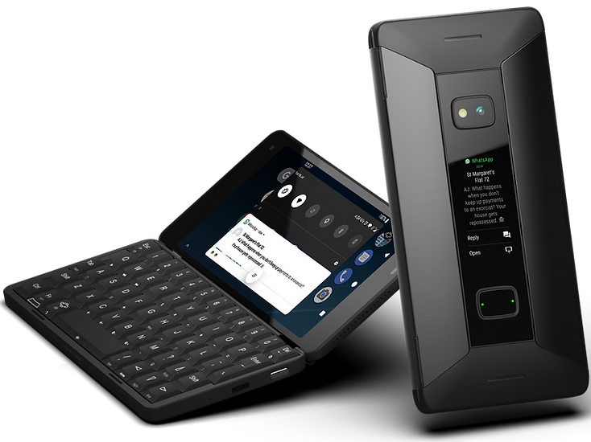
Alternatives
Cosmo Communicator
Calyx OS
Lineage OS
Copperhead OS
UBports

Slide 18
Before Getting Started
Make a checklist of functionality and applications you can’t live without
Be aware that some information and many tutorials you find online may be stale
Clarify what matters to you: FOSS, Linux, hardware kill switches, or just having the spyware ripped out
If your goal is increased privacy, make you don’t sabotage yourself with sketchy applications

Slide 19
Android Emulators
Anbox
Waydroid

Slide 20
Application Sources
Linux
  Flatpak
  Snap
  Stand Linux Repositories
  PureOS Store
  Other
Graphene OS
  Fdroid
  Aurora Store
  Sandboxed Google Play
  APKPure
  Dark, sketchy alleyways

Slide 21
WebApps
What are they?
What I tried out
  Amazon
  Garmin Connect
  Uber

Slide 22
Thoughts on Convergence
Pinephone
Librem 5
Cosmo Communicator

Slide 23
Call Quality
Pinephone
  Poor audio
  Modem kept going to sleep
  Couldn’t get wired headset to work
Librem 5
GrapheneOS

Slide 24
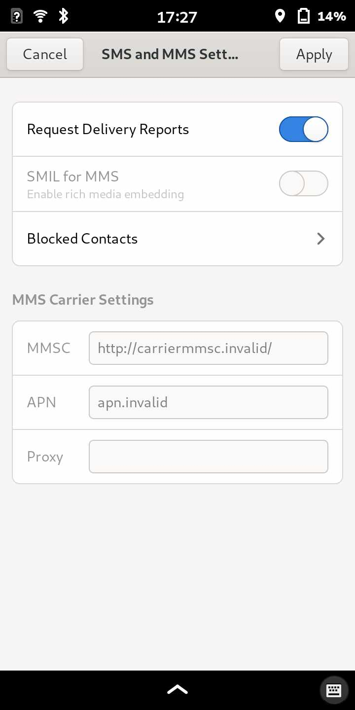
SMS & MMS
Pinephone -Required Setup
Librem 5 -Setup May or May not be Required
GrapheneOS -just works!
Notes:
Inserting or saving pictures in MMS conversations was a little annoying with the Linux phones.
Standard & terminal keyboard available

Slide 25
Disposable Number (MySudo/Google Voice Alternative)
WayDroid on Linux – couldn’t find a viable, working option
Pinephone & Librem 5 – Cheogram + JMP (https://jmp.chat)
  To message a number: “+1thephonenumber@cheogram.com”
  JMP texts appear on same screen as rest of text messages, no separate app required
  Possible to configure VOIP calls, but I couldn’t get it to work
GraphoneOS
  In theory, any Android app like MySudo should work
  Some apps may have reduced functionality or not work if they are dependent on Google Play services
  Standalone Cheogram client available that works for JMP messages

Slide 26
Camera & Software
Pinephone – not as smooth as an iPhone, but it works
Librem 5
  App technically works, but it’s a work-in-progress
  If you don’t know what the “exposure triangle” is, you’ll probably find this really annoying to use.
GrapheneOS
  Just works

Slide 27
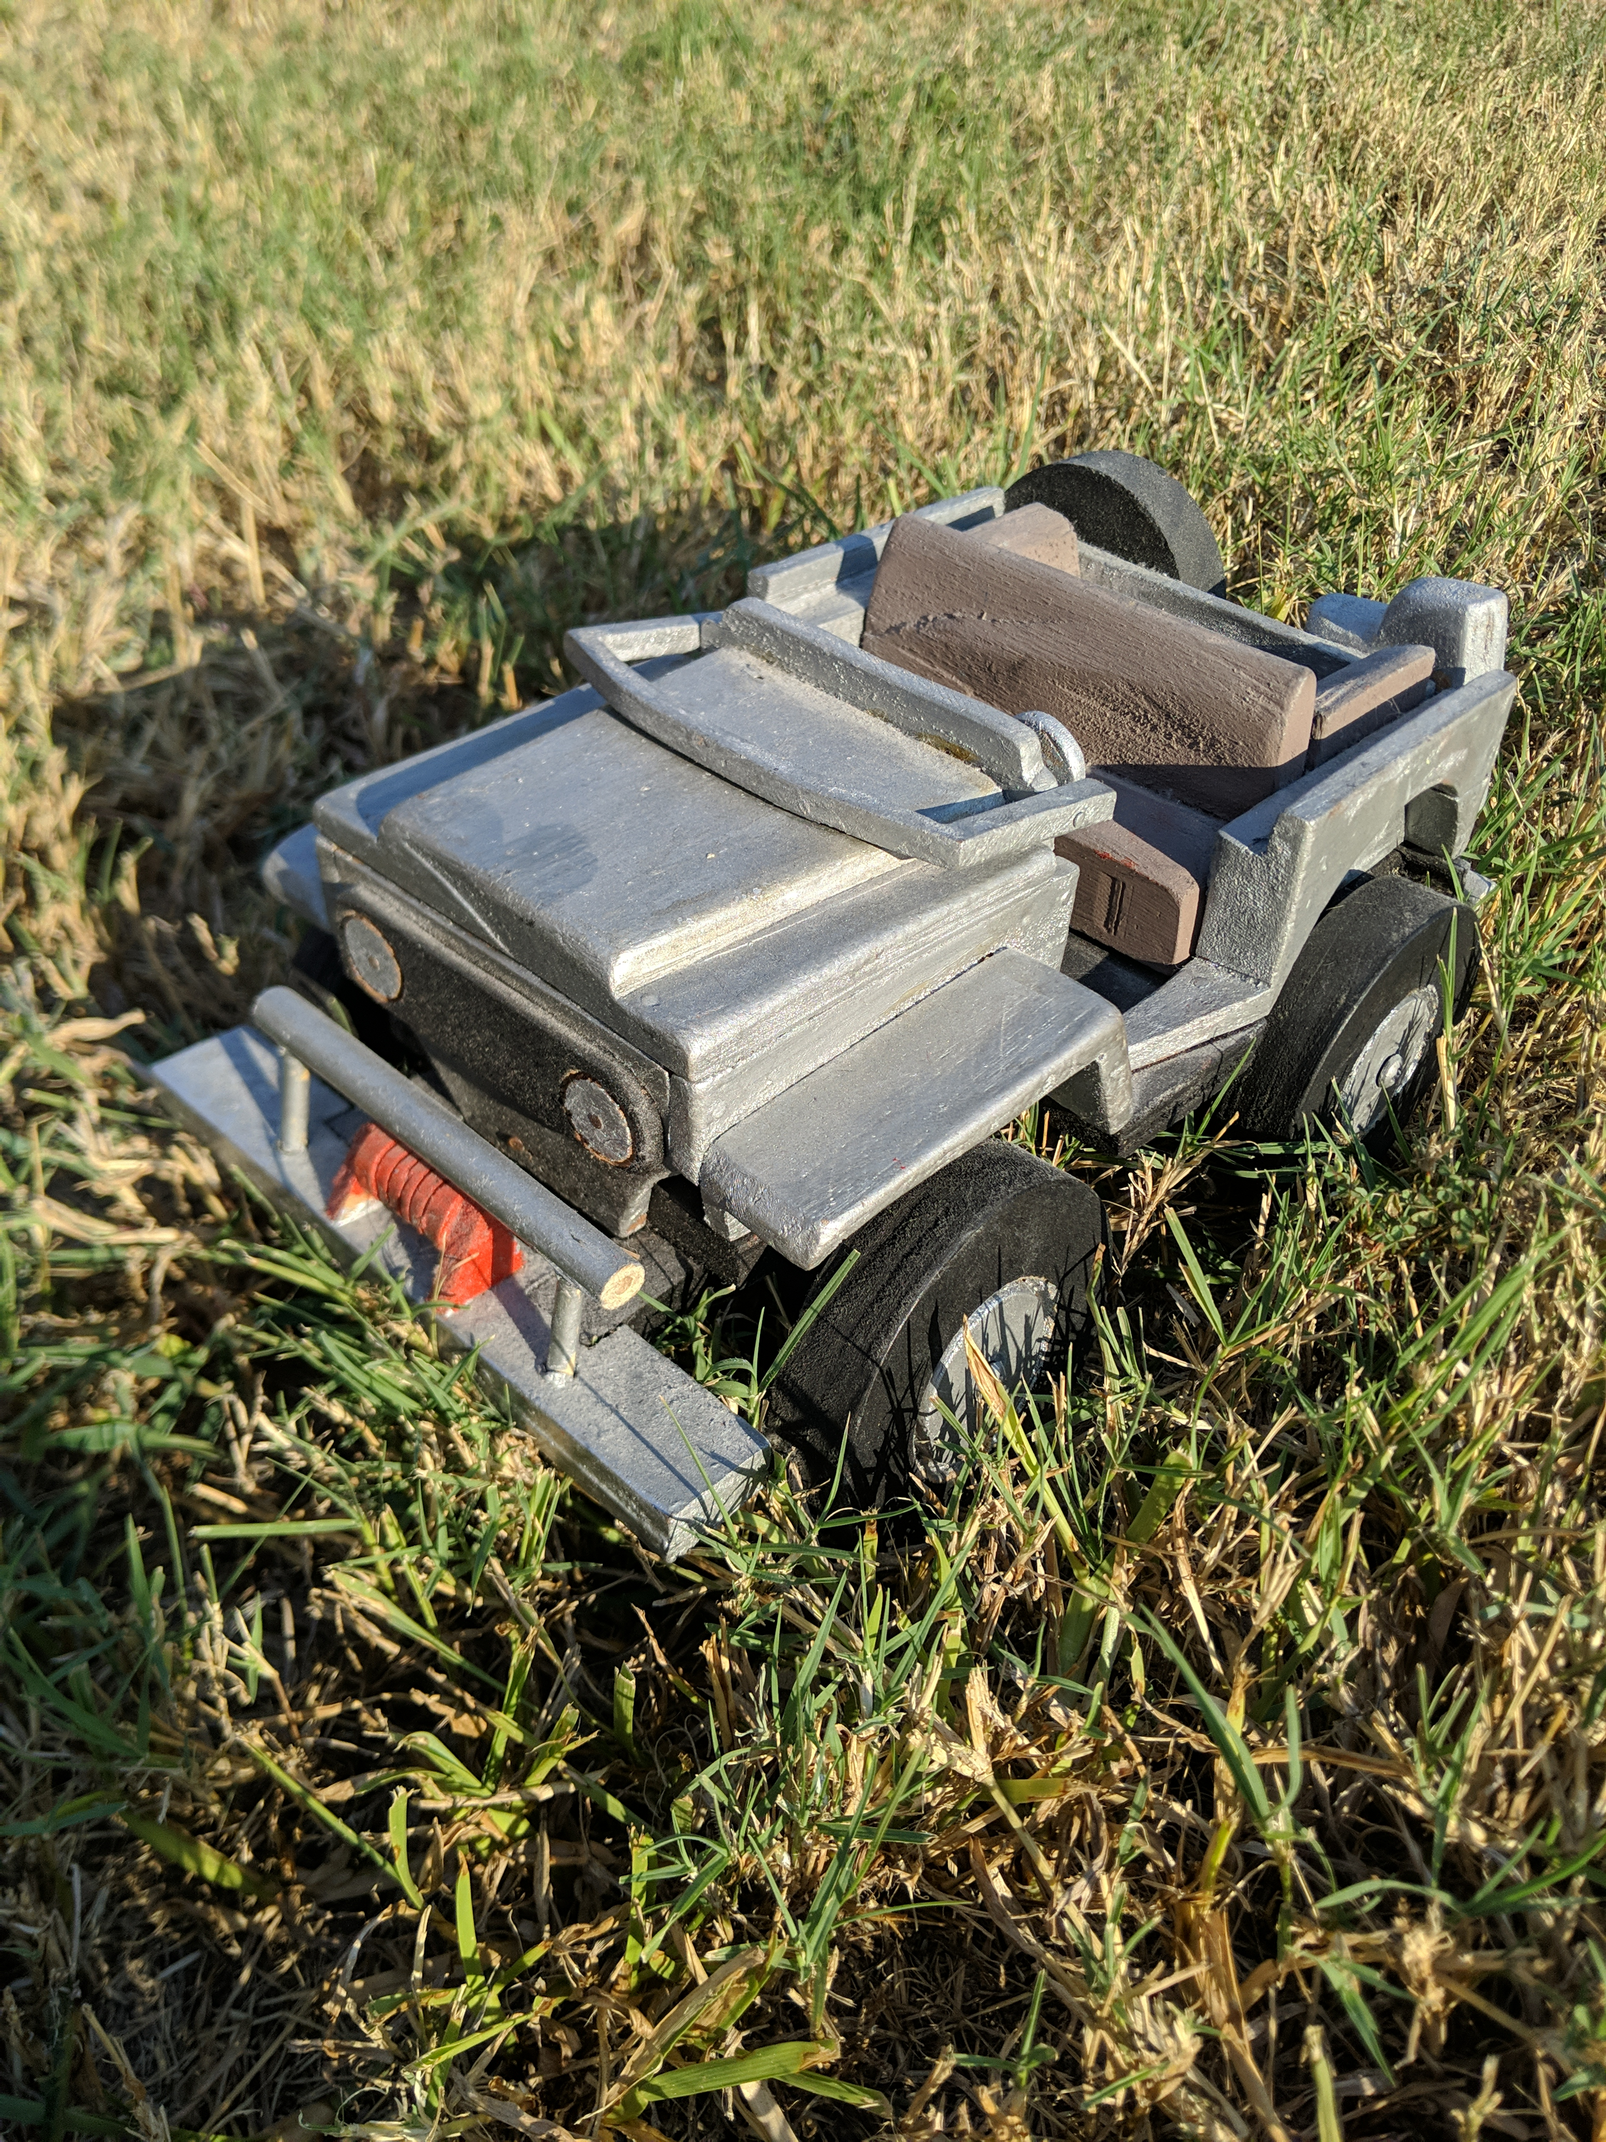
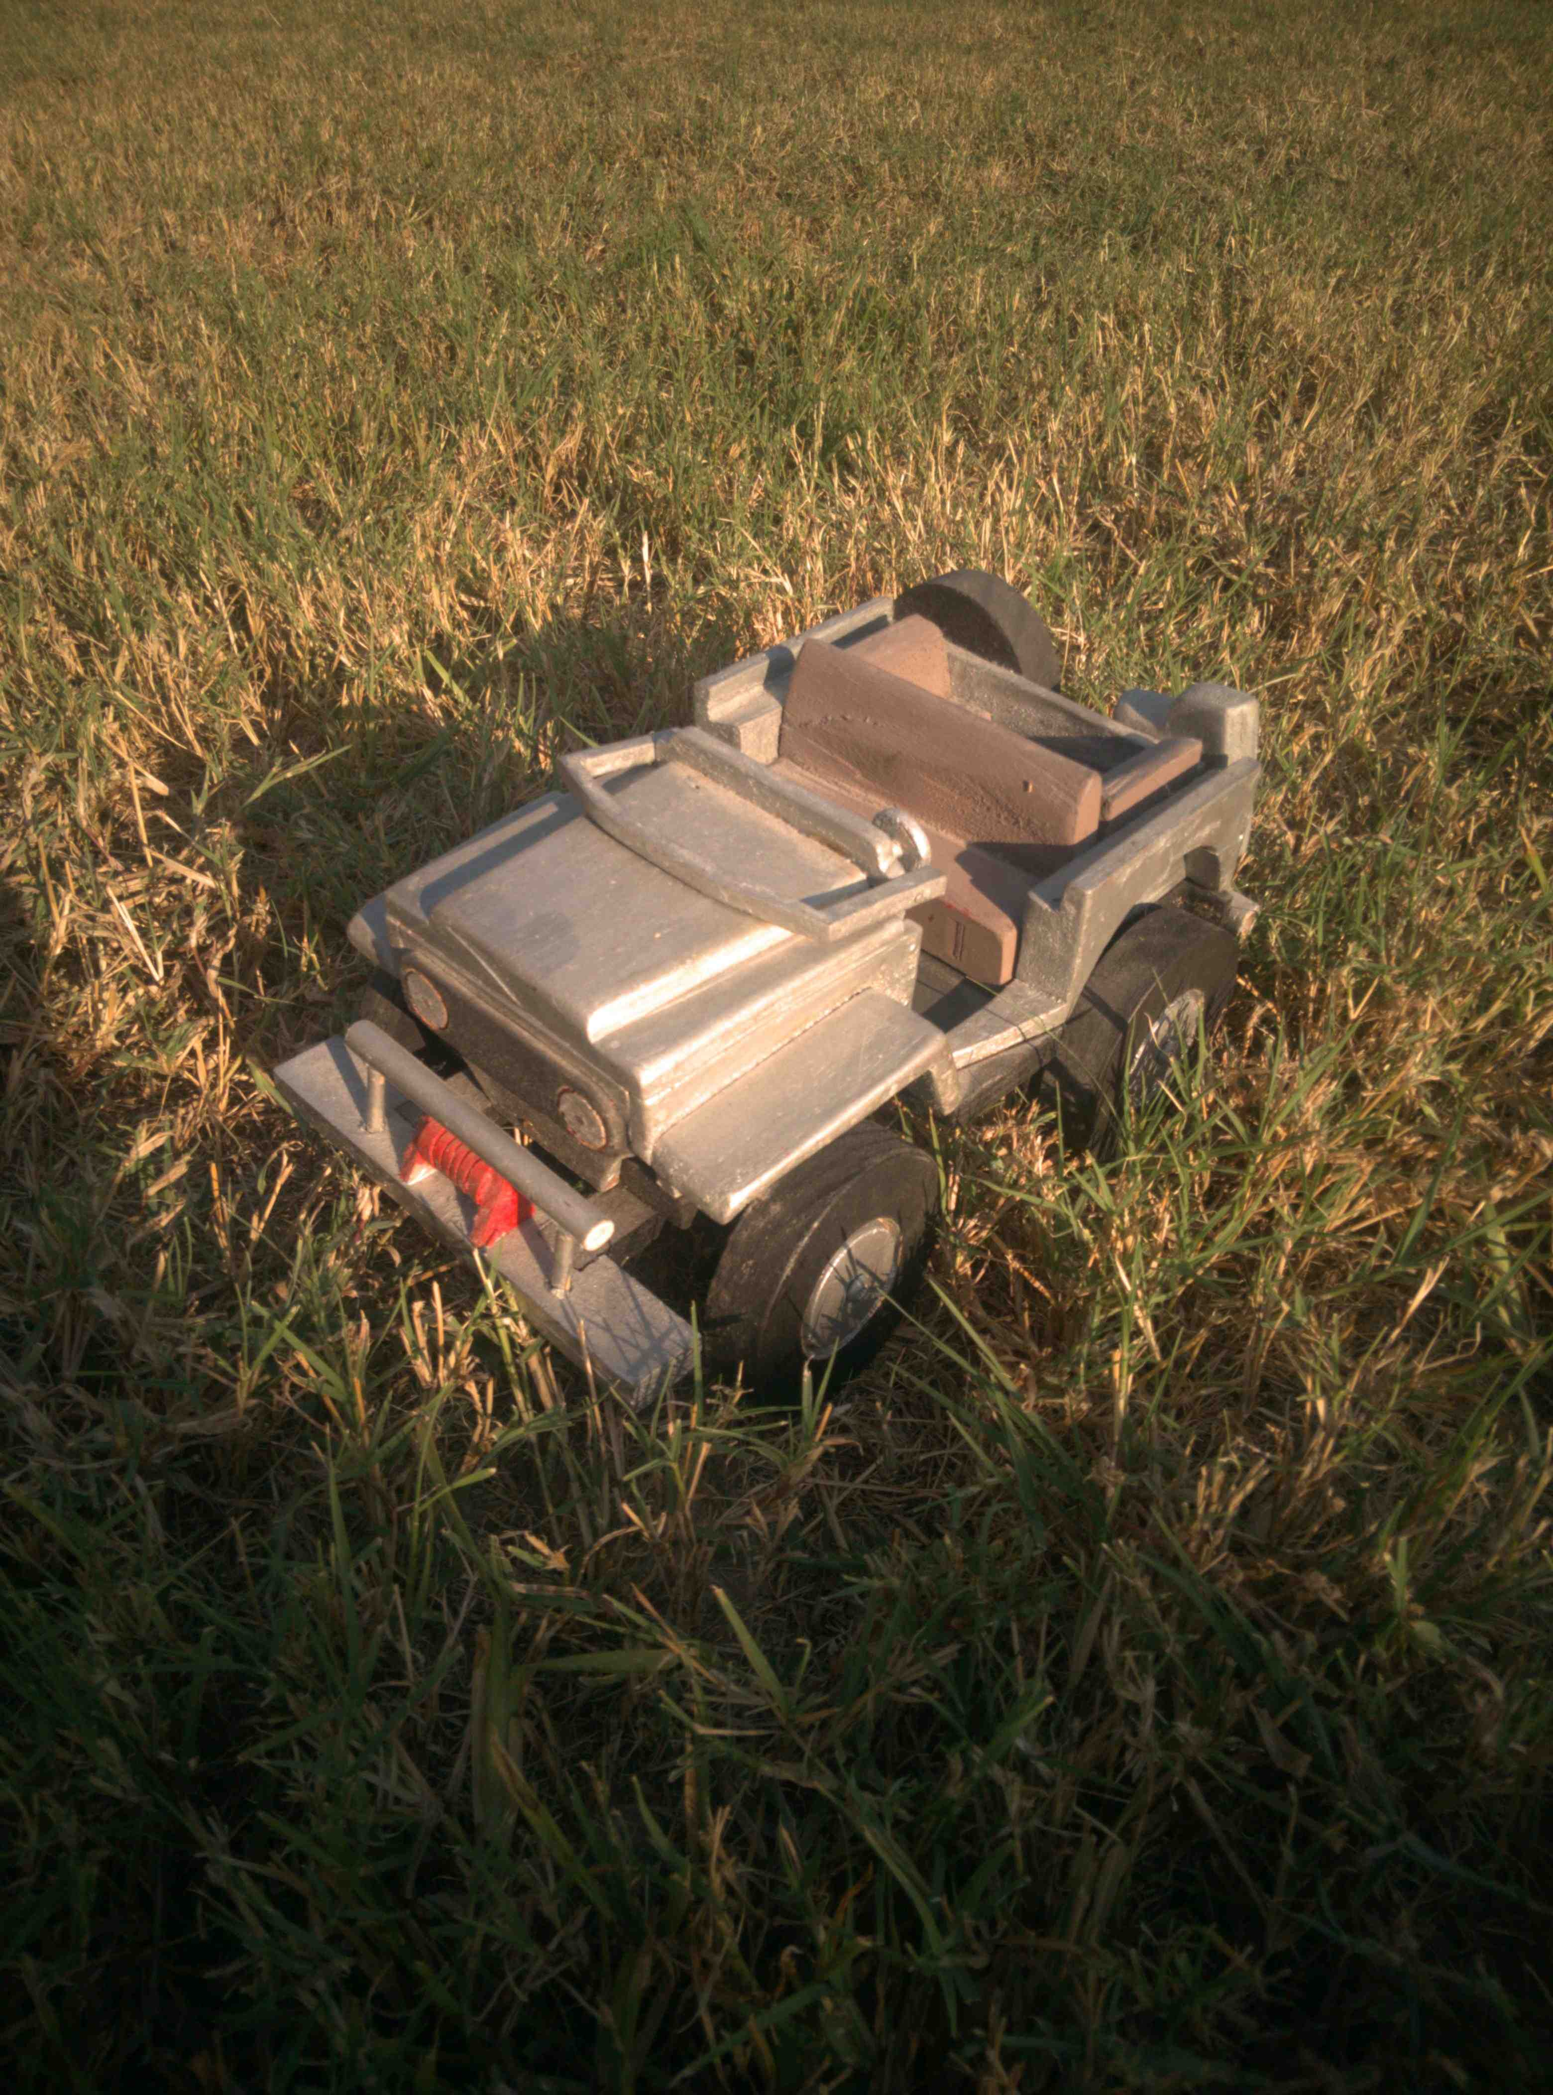
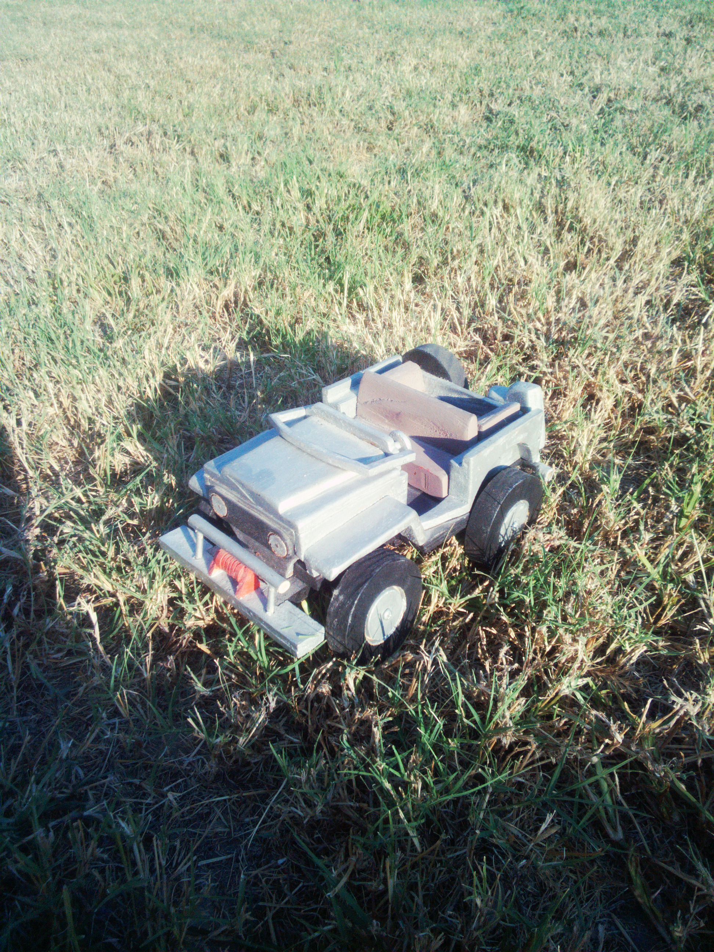
Photos - Outdoors
GrapheneOS (auto settings)
Librem5 (manual settings)
Pinephone (auto settings)

Slide 28
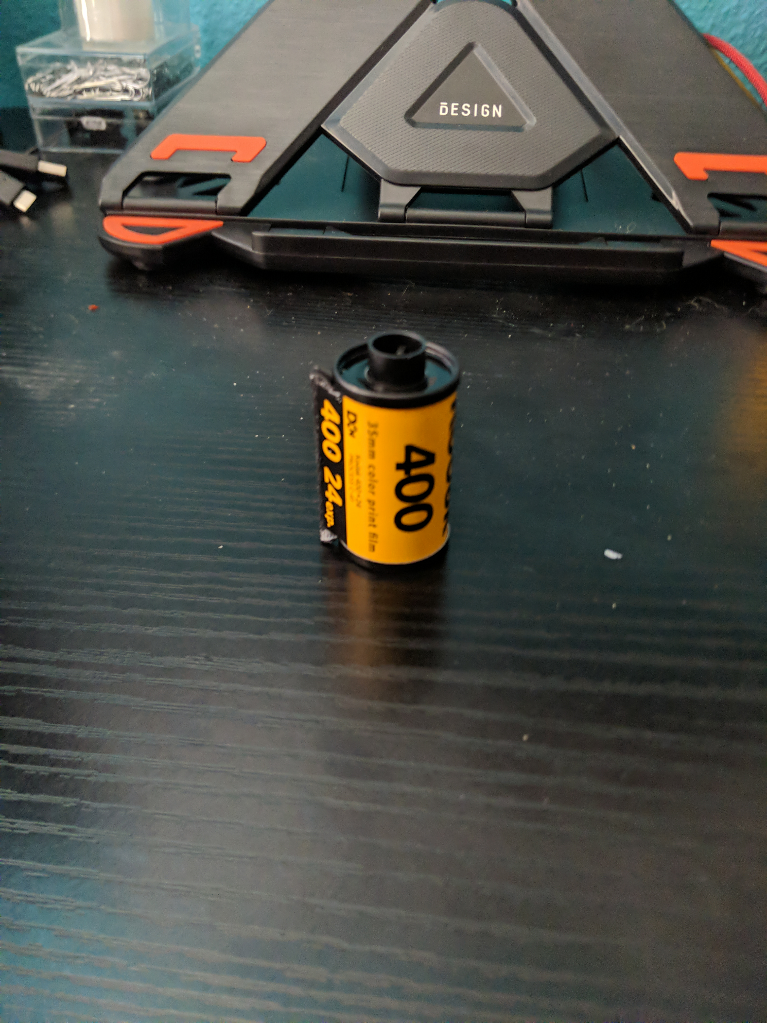
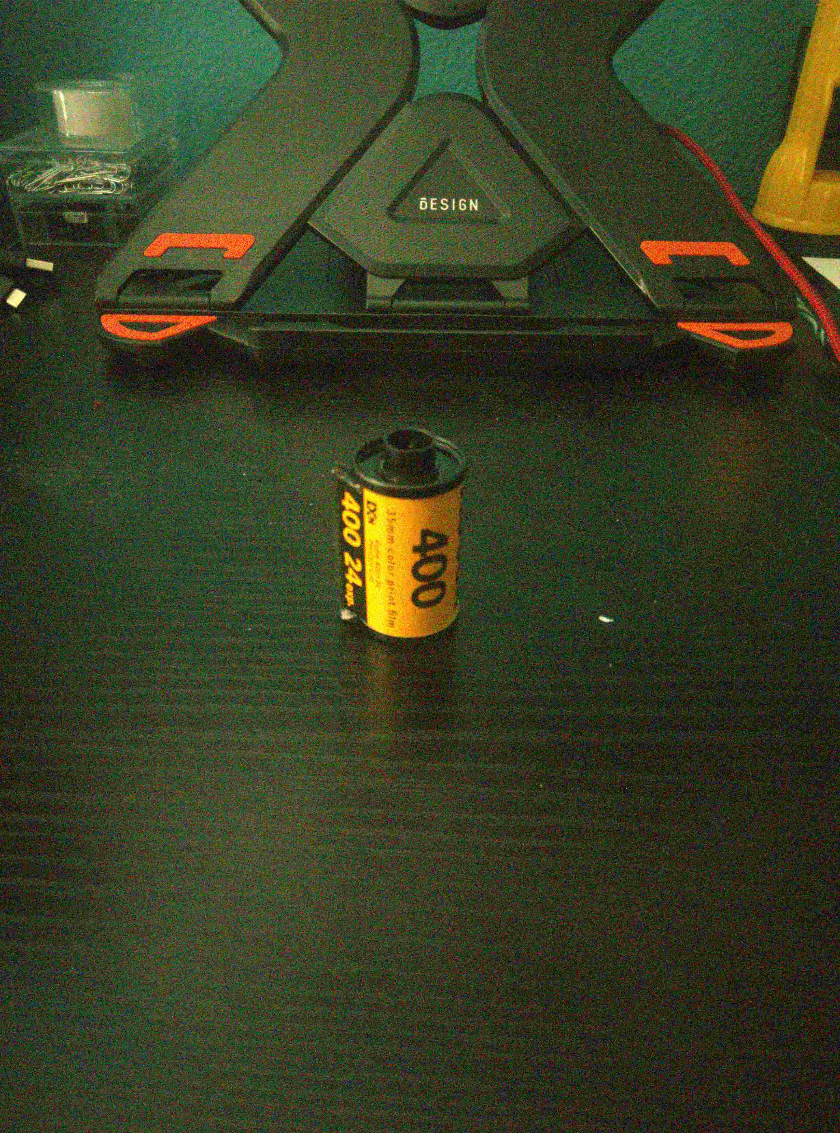
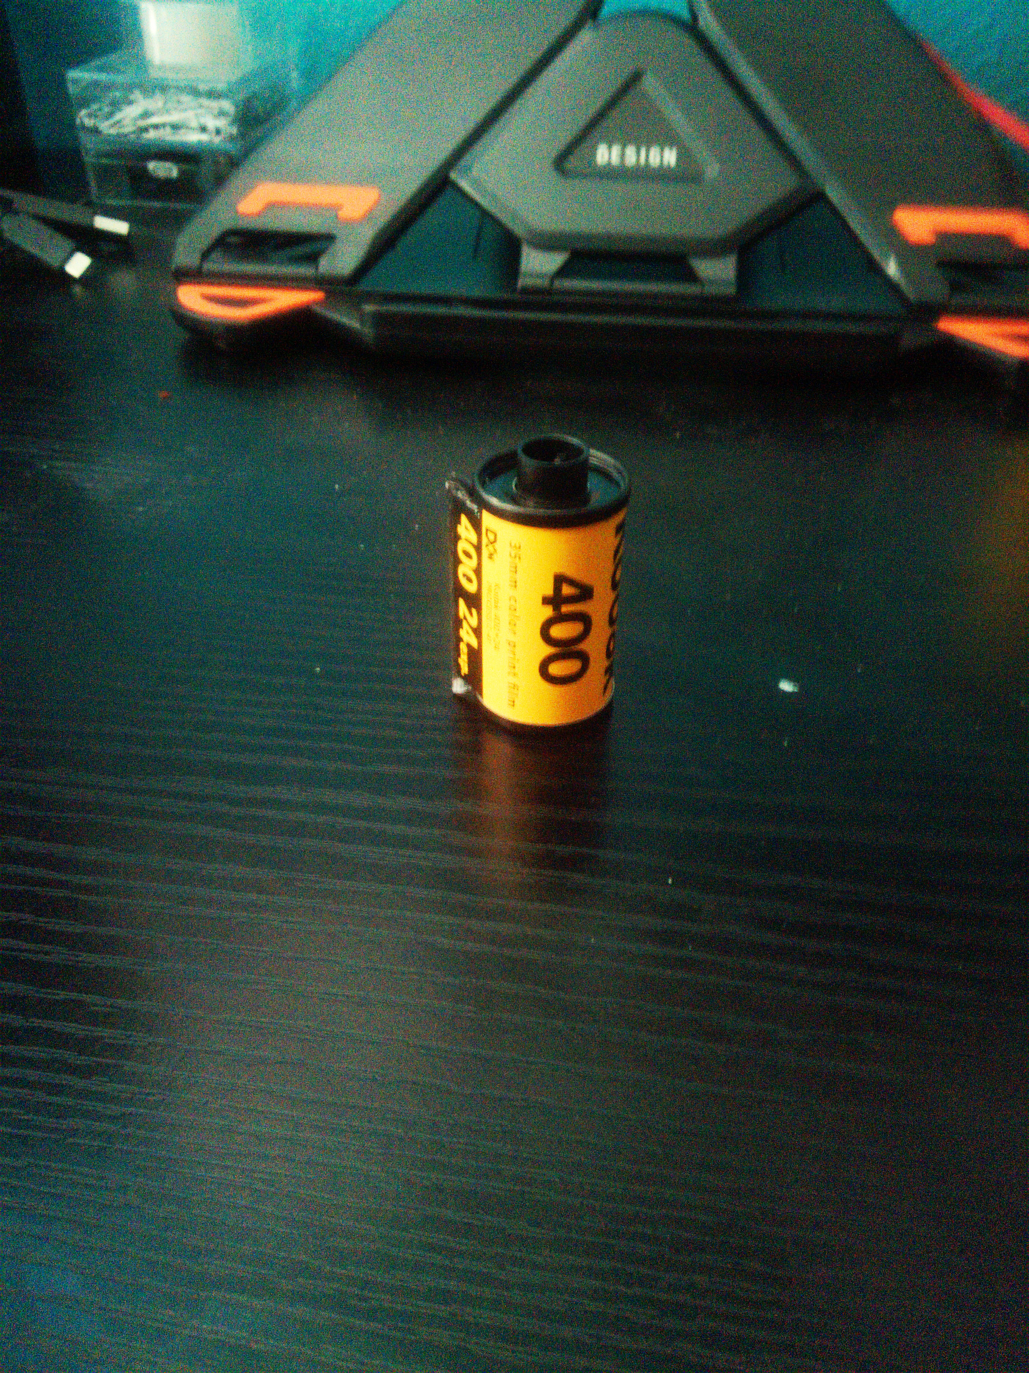
Photos - Indoors
GrapheneOS (auto settings)
Librem5 (manual settings)
Pinephone (auto settings)

Slide 29
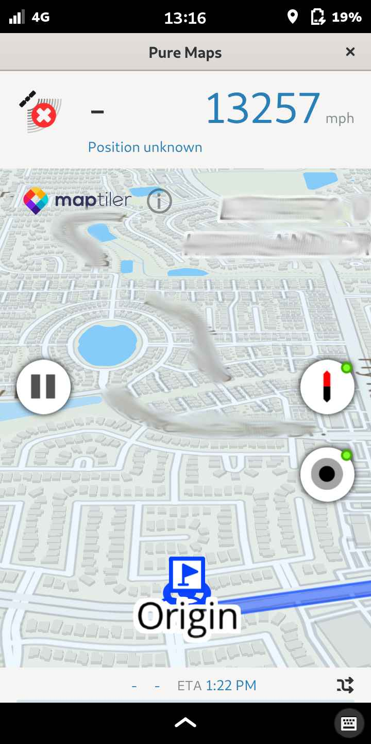
Navigation
Pinephone & Librem 5
  Gnome Maps (just maps, not navigation)
    OpenStreetMap Viewer
      OpenStreetMap database isn’t as complete Google maps, no business info available
  PureMaps (actual GPS navigation)
    I only tested this on the Librem 5
    Was not usable for me
    Slow to locate precise location and could not navigate
    Told me I was traveling at 13,000mph+
GrapheneOS
  Google Maps Web Viewer App (Gmaps WV) on Fdroid
  GoogleMaps/Waze via Aurora Store
  Mapquest (works, but a little quirky)
  OsmAnd (uses open OpenStreetMap DB)
PureMaps

Slide 30
Bluetooth
Pinephone
  Had to install additional utility to make connections
  Had to upgrade firmware on my motorcycle bluetooth to make it usable
  Weird quirk when playing audio at first
Librem 5
  No extra utility was needed to make connections
  Extremely quirky behavior
GrapheneOS
  Just does the thing it’s supposed to do

Slide 31
TOTP
Pinephone & Librem 5
  Authenticator available on Flathub
  Other TOTP options available
GrapheneOS
  FreeOTP+ on Fdroid
  Other TOTP options available

Slide 32
Email Clients
Pinephone & Librem 5
  Multiple options available, but don’t display properly
  Geary is the default and only option that is scaled for a phone display
    Unusable due to bizarre issue where the is a discrepancy between input and display
GrapheneOS
  K-9 Mail of FDroid
  Librem Mail
  Other options available

Slide 33
Podcasts
Pinephone & Librem 5
  GNOME Podcasts
GrapheneOS
  Multiple options available

Slide 34
Music (Local Storage)
Pinephone & Librem 5
  Lollypop
    I found it difficult to use
  Elisa
    Easier to use, but had to scale screen to set up my playlists
GrapheneOS
  SicMu Player on FDroid
    Uses folder hagiarchy to create playlists
    Other options available

Slide 35
Music (Cloud) & YouTube
No viable SoundCloud agent available for Linux with ARM64 Support
FreeTube -Linux utility for using YouTube without an account
LibreTube -Android app for using YouTube without an account
NewPipe -Android app for using YouTube, SoundCloud, media.ccc.de, FramaTube, and Bandcamp

Slide 36
Music (Cloud) & YouTube
CastNow -Linux command line utility available for casting local media
Kodi - casting alternative for Android/GrapheneOS

Slide 37
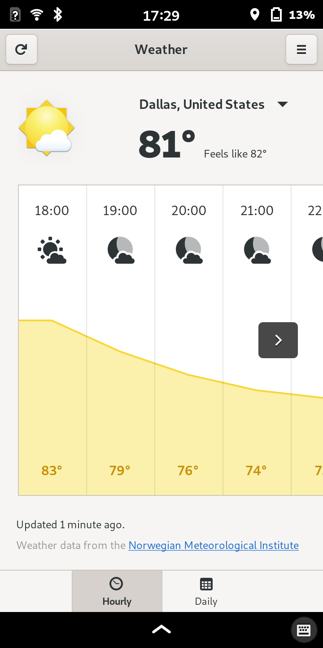
Weather
Pinephone & Librem 5
  GNOME Weather
    Adequate, doesn’t use your location
GrapheneOS
  Multiple options available on FDroid
GNOME Weather

Slide 38
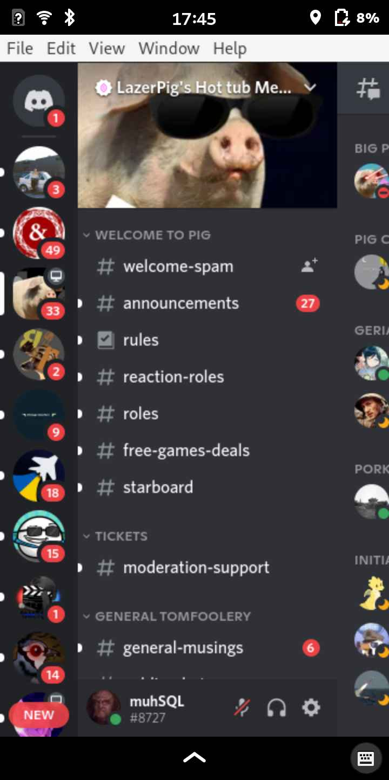
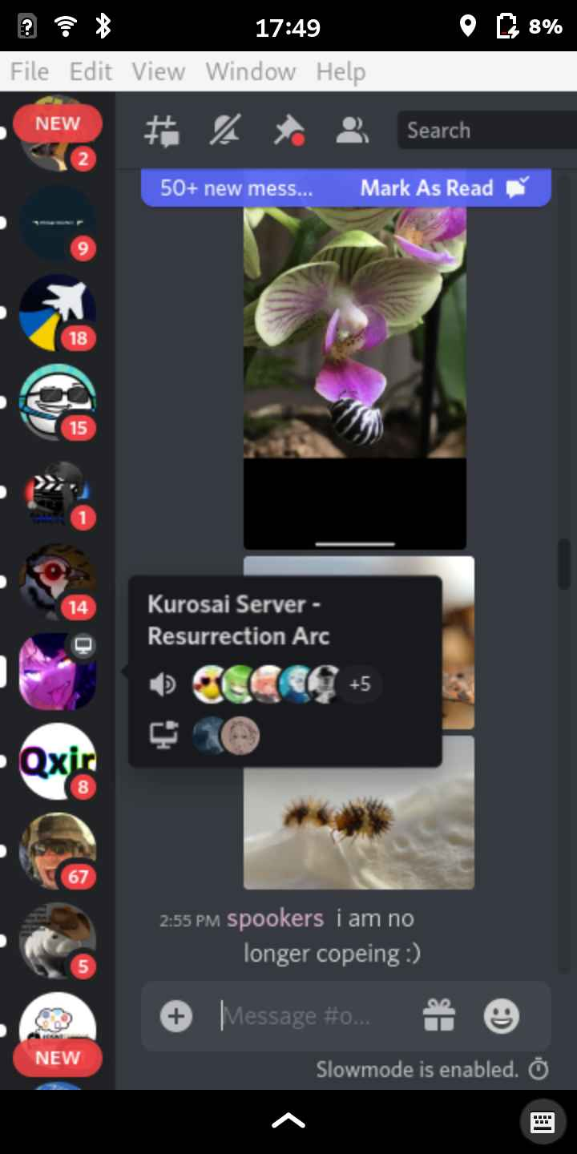
Discord
Pinephone & Librem 5
  Webcord
  Armcord
GrapheneOS
  Regular Discord
Webcord

Slide 39
Whitenoise
Pinephone & Librem 5
  Blanket
  Bose Sleep (did not work on Waydroid)
    Workaround: configured sleep buds to operate without cell phone
GrapheneOS
  Bose Sleep
  Other apps available

Slide 40
Alarm Clock
Works on all devices

Slide 41
Audiobooks
Could not get Audible to work on Waydroid
Audible web player worked on Linux, when using “UnGoogled Chrome” browser that supports Audible’s DRM
OpenAudible + Cozy or other Linux audio book player
  Could not get OpenAudible working directly on the Librem 5, did not experiment with Pinephone
Audible works on GrapheneOS

Slide 42
Garmin Connect
Worked on Waydroid
Web App on Linux was really quirky
Worked on Graphene OS, but spammed my watch with some kind of error message

Slide 43
Quirks
Pinephone
Form factor
Soft bezel
Lack of good cases
Call Audio quality
Navigation
Email
Boot loop
Modem sleep
Librem 5
Camera
Navigation
Email
Bluetooth
Waydroid
Kill Switches
Graphene OS
Device Lifecycle
No headphone jack
No default calendar
Recommend using Blokada 5

Slide 44
Conclusions & Recommendations
Librem 5 has better functionality (minus the camera) over Pinephone
  Would have liked to compare it to the Pinephone Pro
GrapheneOS is the least painful to adopt by far
Why I don’t miss hardware kill switches on my Pixel 3 with GrapheneOS
GrapheneOS -Careful app selection along with Firewall App, such as Blokada 5 for maximum privacy
Secure Communications – PGP + Email, Signal for Graphene, Librem Chat (Matrix makes it a little sketchy)
Consider other “smart” IOT devices in your home.

Slide 45
Q&A
Contact me via email or Librem Chat at klindbloom@tuta.com

